Slide 1

503106
ADVANCED WEB PROGRAMMING
CHAPTER 9: STATIC CONTENT
LESSON 09 – STATIC CONTENT

Slide 2
Performance Considerations
The two primary perfor‐ mance considerations are reducing the number of requests and reducing content size.
Combining resources
Reduce the size of static resources.

Slide 3
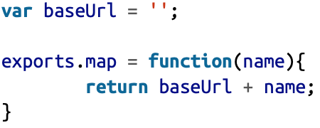
Static Mapping
you want to be able to write <img src="/img/meadow lark_logo.png" alt="Meadowlark Travel Logo">, not <img src="//s3-us- west-2.amazonaws.com/meadowlark/img/meadowlark_logo-3.png" alt="Meadow lark Travel Logo">
we wish to map less specific paths (/img/ meadowlark_logo.png) to more specific paths (//s3-us-west-2.amazonaws.com/mead‐ owlark/img/meadowlark_logo-3.png)
Let’s create a file called lib/static.js:

Slide 4
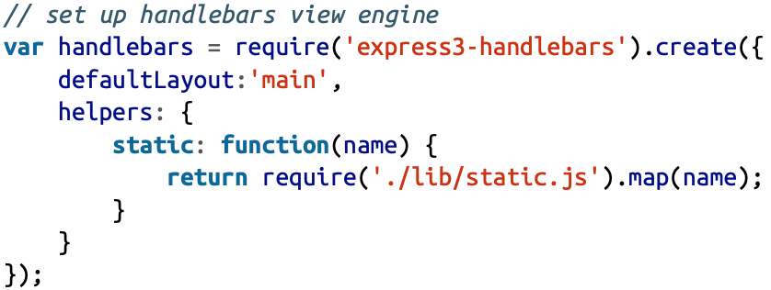

Static Resources in Views
We can create a Handlebars helper
We added a Handlebars helper called static

Slide 5
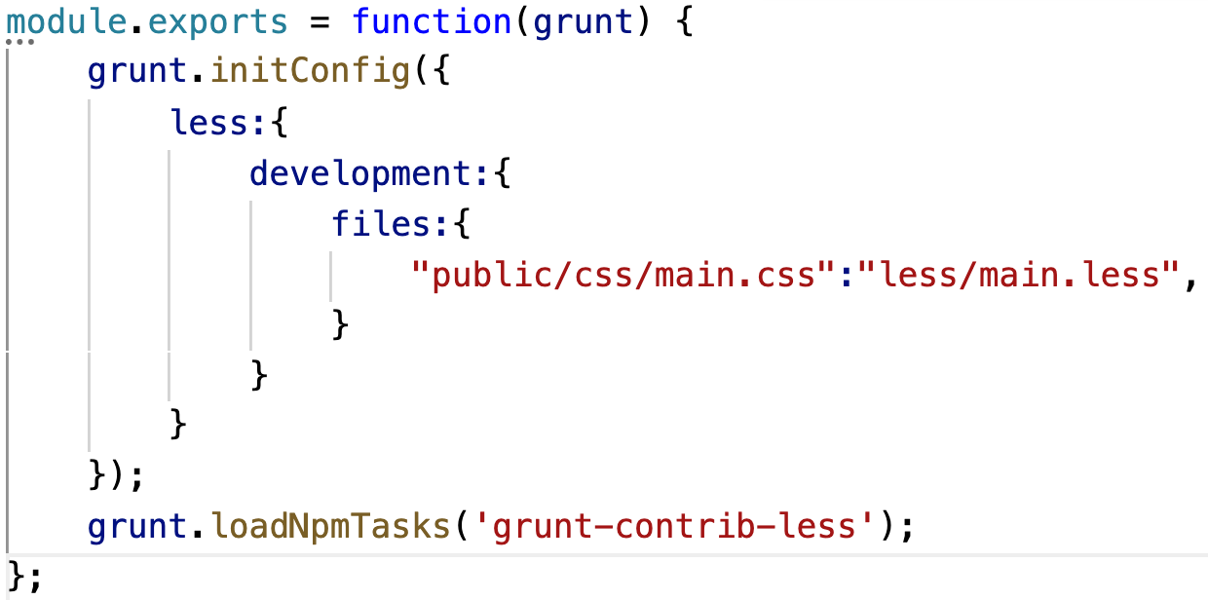
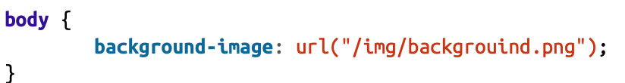

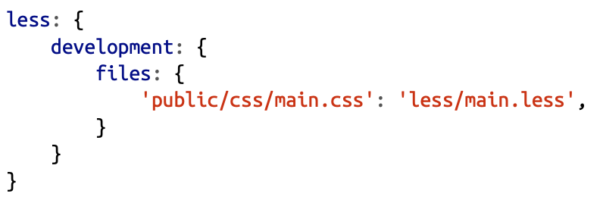
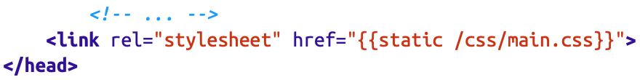

Static Resources in CSS
Cài package cần:
npm install -g grunt-cli
npm install grunt
Use LESS to work with CSS
Like main.less:
Now we need a way to compile the LESS to generate CSS. We’ll use a Grunt task for that: (npm install --save-dev grunt-contrib-less)
Then modify Gruntfile.js. Add grunt-contrib-less to the list of Grunt tasks to load, then add the following section to grunt.initConfig:
then use in template:
grunt less to create CSS file

Slide 6
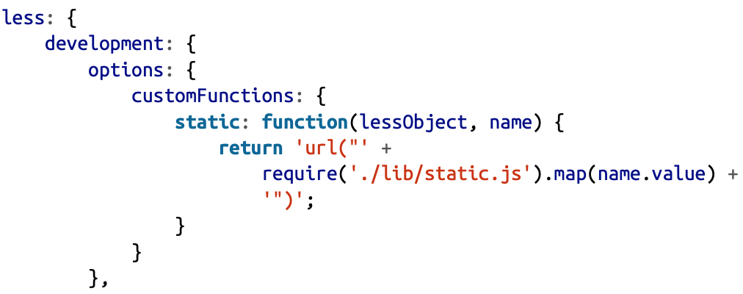
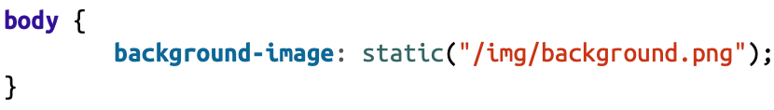
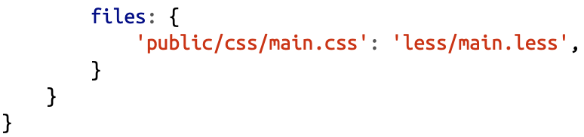
Static Resources in CSS
Link our static mapper as a LESS custom function. This can all be accomplished in Gruntfile.js:
Now all we have to do is modify our LESS file, less/main.less:

Slide 7
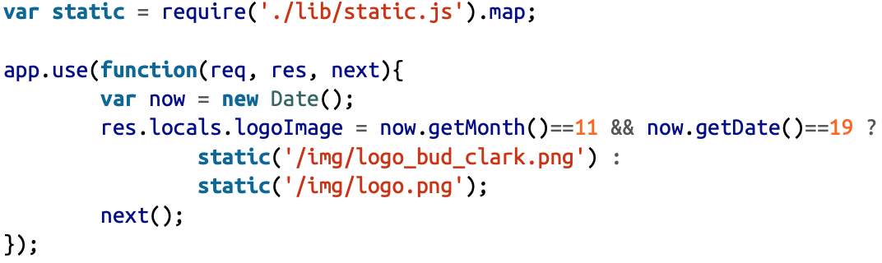
Static Resources in Server-Side JavaScript
Using our static mapper in server-side JavaScript is really easy, as we’ve already written a module to do our mapping. For example, we want to change logo on 19 – Nov every month (Boss birthday)
Then link in view:

Slide 8
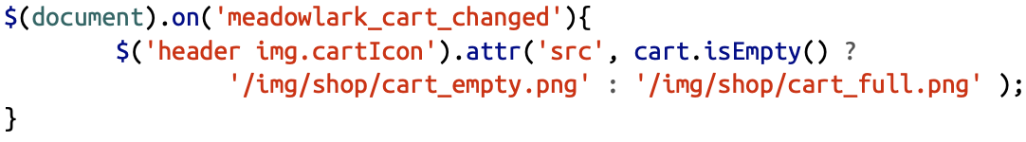
Static Resources in Client-Side JavaScript
The solution is just to do the mapping on the server, and set custom JavaScript variables.
Our two images are called /img/shop/cart_empty.png and /img/shop/cart_full.png. Without mapping, we might use something like this:
What happen when we change static root?

Slide 9
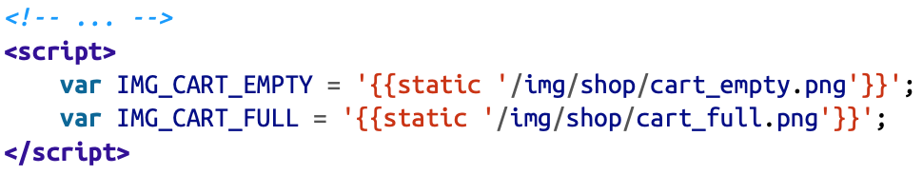
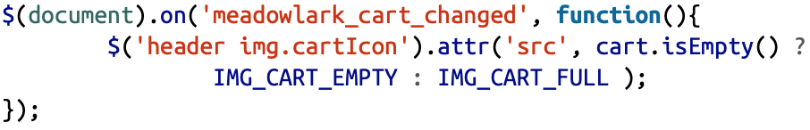
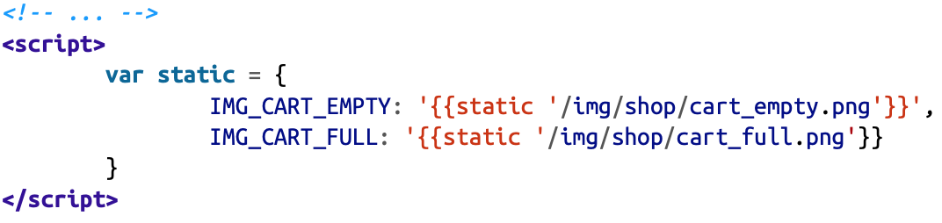
Static Resources in Client-Side JavaScript
In view we can do
Then our jQuery simply uses those variables:
If you do a lot of image swapping on the client side, you’ll probably want to consider organizing all of your image variables in an object

Slide 10
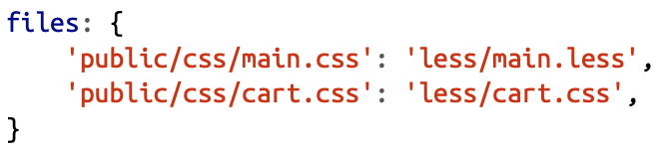
Bundling and Minification
In an effort to reduce HTTP requests and reduce the data sent over the wire, “bundling and minification” has become popular. Bundling takes like files (CSS or JavaScript) and bundles multiple files into one (thereby reducing HTTP requests). Minification removes anything unnecessary from your source, such as whitespace (outside of strings), and it can even rename your variables to something shorter.
For example, we have public/js/contact.js, public/js/cart.js, less/main.less and less/cart.less
Now in Gruntfile.js add it to the list of LESS files to compile:

Slide 11
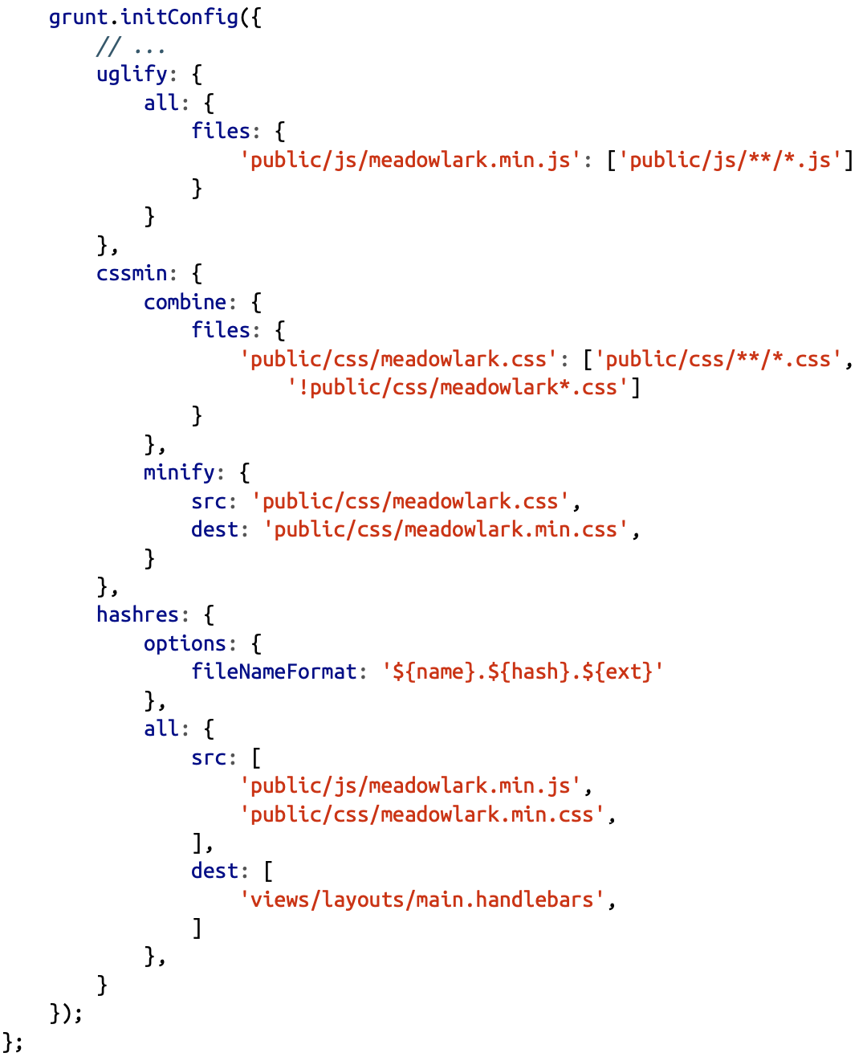
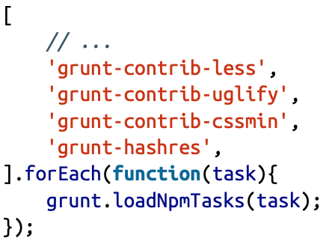
Bundling and Minification
Let’s go ahead and install those modules now:
npm install --save-dev grunt-contrib-uglify npm install --save-dev grunt-contrib-cssmin npm install --save-dev grunt-hashres
Then load these tasks in the Gruntfile:
And set up the tasks:

Slide 12
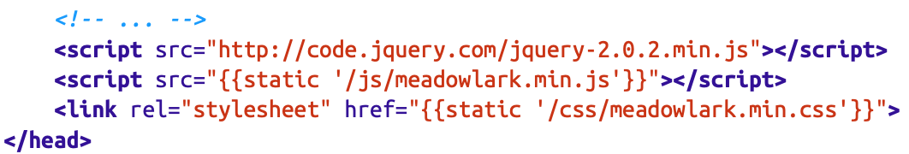
Bundling and Minification
Let’s modify our layout file:
hashres will generate a hash of the file (a mathematical fingerprinting) and append it to the file. So now, instead of /js/meadowlark.min.js, you’ll have /js/meadowlark.min.62a6f623.js

Slide 13
Bundling and Minification
So now let’s give it a try. It’s important that we do things in the right order, because these tasks have dependencies:
grunt less
grunt cssmin
grunt uglify
grunt hashres
That’s a lot of work every time we want to change our CSS or JavaScript, so let’s set up a Grunt task so we don’t have to remember all that. Modify Gruntfile.js:
Now all we have to do is type grunt static

Slide 14
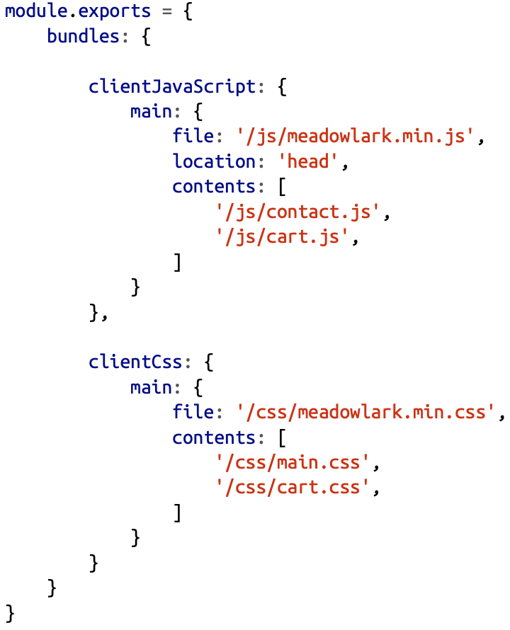
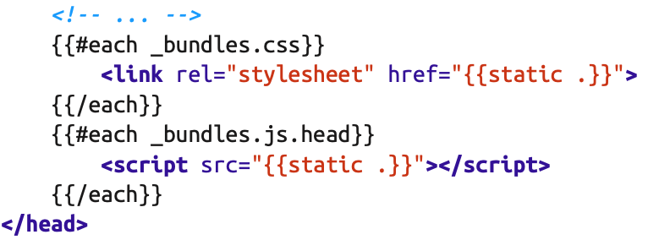
Skipping Bundling and Minification in Development Mode
One problem with bundling and minification is that it makes frontend debugging all but impossible. We need to disable bundling and minification in development mode
First install connect-bundle then create config.js and modify views/layouts/main.handlebars:

Slide 15
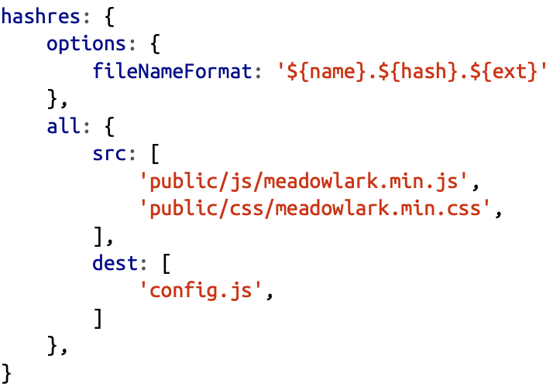
Skipping Bundling and Minification in Development Mode
Finally, modify Gruntfile.js
Now you can run grunt static; you’ll see that config.js has been updated

Slide 16
Security

Slide 17
HTTPS
The first step in providing secure services is using HTTP Secure (HTTPS). The nature of the Internet makes it possible for a third party to intercept packets being transmitted between clients and servers. HTTPS encrypts those packets, making it extremely difficult for an attacker to get access to the information being transmitted.
The HTTPS protocol is based on the server having a public key certificate, sometimes called an SSL certificate.
The current standard format for SSL certificates is called X. 509.

Slide 18
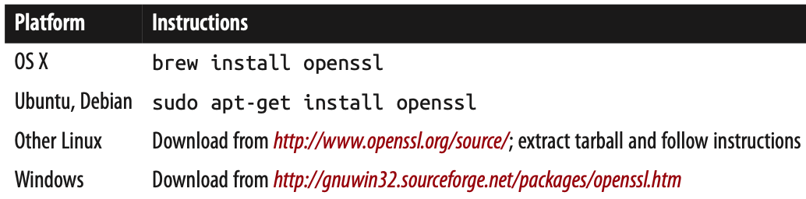
Generating Your Own Certificate
Generating your own certificate is easy, but generally suitable only for development and testing purposes (and possibly for intranet deployment).
You’ll need an OpenSSL
Then run command below to create it:
openssl req -x509 -nodes -days 365 -newkey rsa:2048 -keyout meadowlark.pem -out meadowlark.crt

Slide 19
Generating Your Own Certificate
The result of the command is two files, meadowlark.pem and meadowlark.crt. The PEM (Privacy-enhanced Electronic Mail) file is your private key, and should not be made available to the client. The CRT file is the self-signed certificate that will be sent to the browser to establish a secure connection.
Alternatively, there are websites that will provide free self-signed certificates, such as http://www.selfsignedcertificate.com.

Slide 20
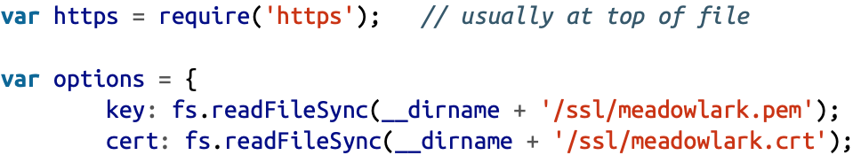
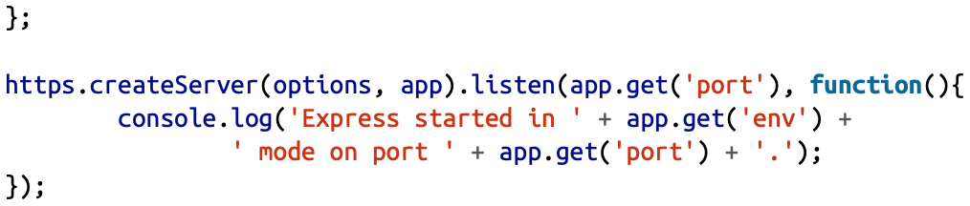
Enabling HTTPS for Your Express App
Put your private key and SSL cert in a subdirectory called ssl then you just use the https module instead of http
You can now connect to https://localhost:3000. If you try to connect to http://localhost:3000, it will simply time out.

Slide 21
Cross-Site Request Forgery
Cross-site request forgery (CSRF) attacks exploit the fact that users generally trust their browser and visit multiple sites in the same session. In a CSRF attack, script on a malicious site makes requests of another site: if you are logged in on the other site, the malicious site can successfully access secure data from another site.
To prevent CSRF attacks, you must have a way to make sure a request legitimately came from your website. The way we do this is to pass a unique token to the browser. When the browser then submits a form, the server checks to make sure the token matches.

Slide 22
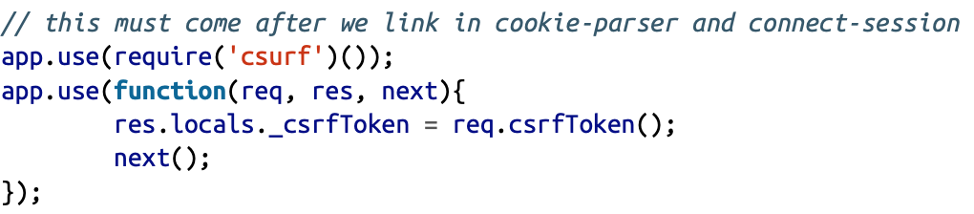
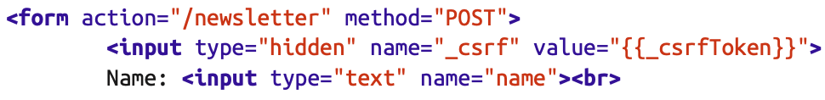
Cross-Site Request Forgery
The csurf middleware will handle the token creation and verification for you; all you’ll have to do is make sure the token is included in requests to the server. Install the csurf middleware (npm install --save csurf), then link it in and add a token to res.locals:
Now on all of your forms (and AJAX calls), you’ll have to provide a field called _csrf, which must match the generated token.

Slide 23
Authentication

Slide 24
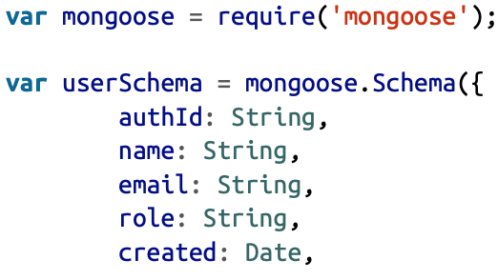
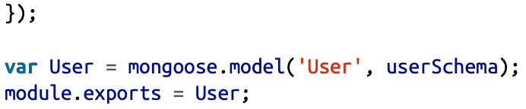
Storing Users in Your Database
Whether or not you rely on a third party to authenticate your users, you will want to store a record of users in your own database.
So let’s create a model for our users, models/user.js:

Slide 25
Third-Party Authentication
Third-party authentication takes advantage of the fact that pretty much everyone on the Internet has an account on at least one major service, such as Google, Facebook, Twitter, or LinkedIn. All of these services provide a mechanism to authenticate and identify your users through their service.

Slide 26
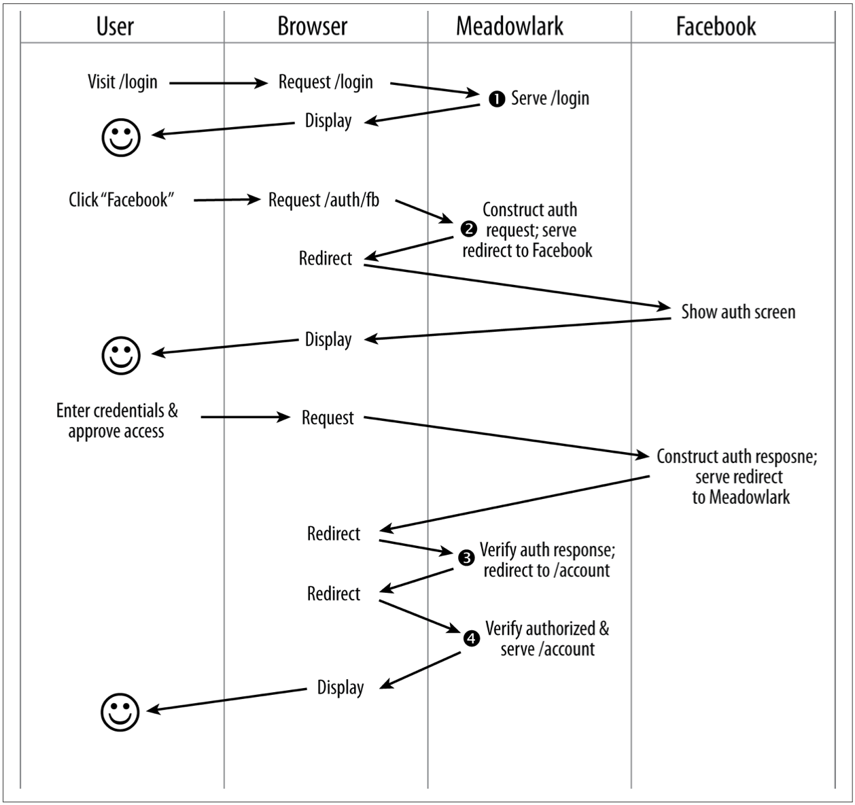
Passport
Passport is a very popular and robust authentication module for Node/Express. It is not tied to any one authentication mechanism; rather, it is based on the idea of pluggable authentication strategies (including a local strategy if you don’t want to use third-party authentication).
When you use Passport, there are four steps that your app will be responsible for. Consider a more detailed view of the third-party authentication flow

Slide 27
Setting up Passport
To keep things simple, we’ll start with a single authentication provider. Arbitrarily, we’ll choose Facebook. Before we can set up Passport and the Facebook strategy, we’ll need to do a little configuration in Facebook. For Facebook authentication, you’ll need a Facebook app.
Then let’s install Passport, and the Facebook authentication strategy:
npm install --save passport passport-facebook

Slide 28
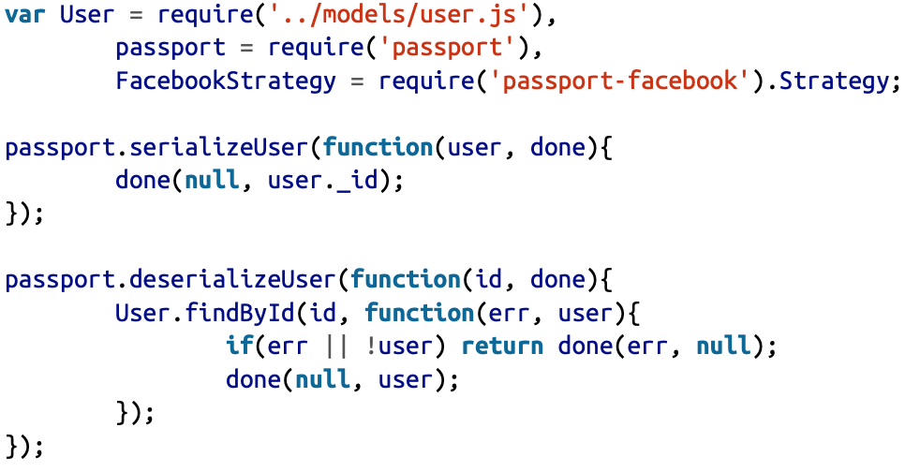
Setting up Passport
We’ll start with the imports and two methods that Passport requires, serializeUser and deserializeUser.
Passport uses serializeUser and deserializeUser to map requests to the authenticated user, allowing you to use whatever storage method you want. In our case, we are only going to store the MongoDB-assigned ID (the _id property of User model instances) in the session.

Slide 29
Setting up Passport
Once these two methods are implemented, as long as there is an active session, and the user has successfully authenticated, req.session.passport.user will be the corresponding User model instance.
Next, we’re going to choose what to export. To enable Passport’s functionality, we’ll need to do two distinct activities: initialize Passport and register routes that will handle authentication and the redirected callbacks from our third-party authentication services.

Slide 30
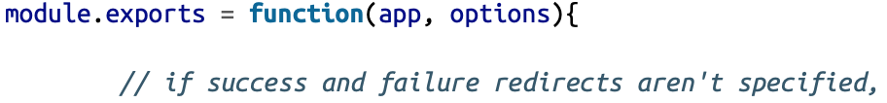
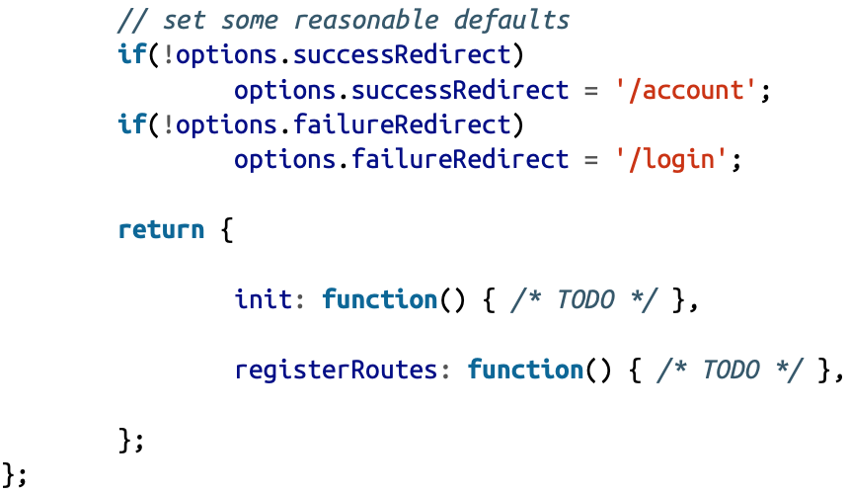
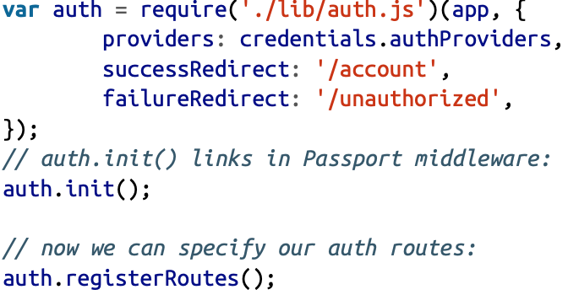
Setting up Passport
Also, since we need to link the Passport middleware into our application, a function is an easy way to pass in the Express application object:
Before we get into the details of the init and registerRoutes methods, let’s look at how we’ll use this module

Slide 31
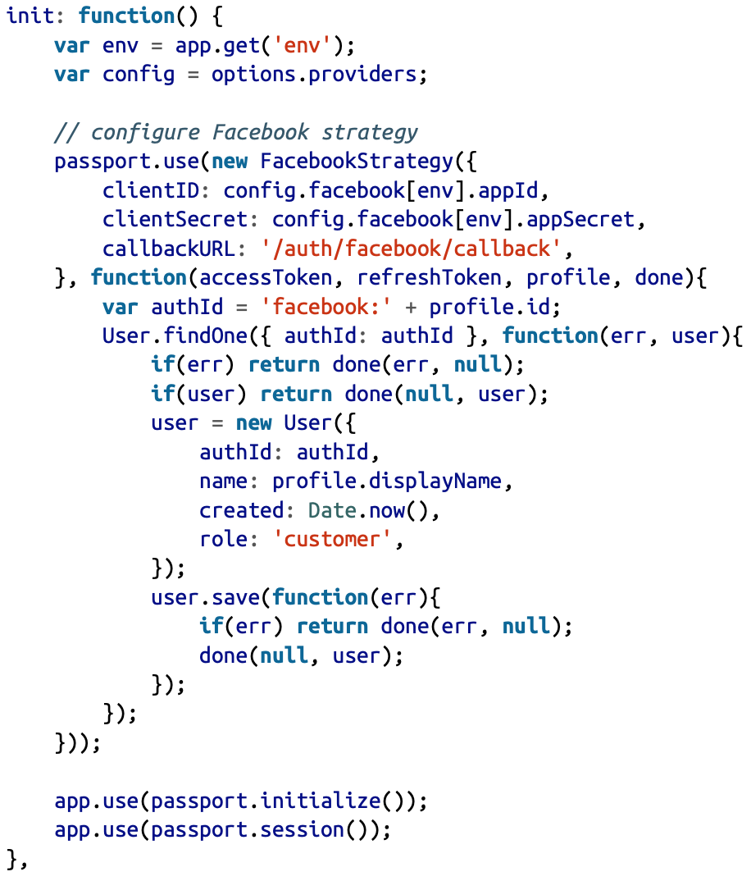
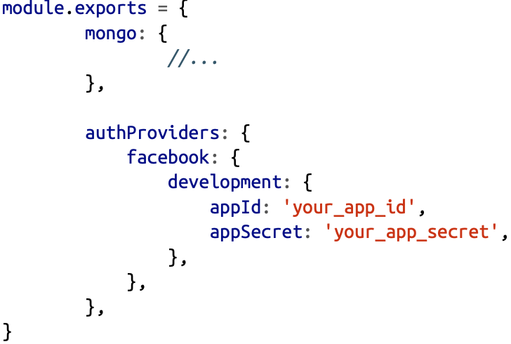
Setting up Passport
We’ll need to add the authProviders property to credentials.js:

Slide 32
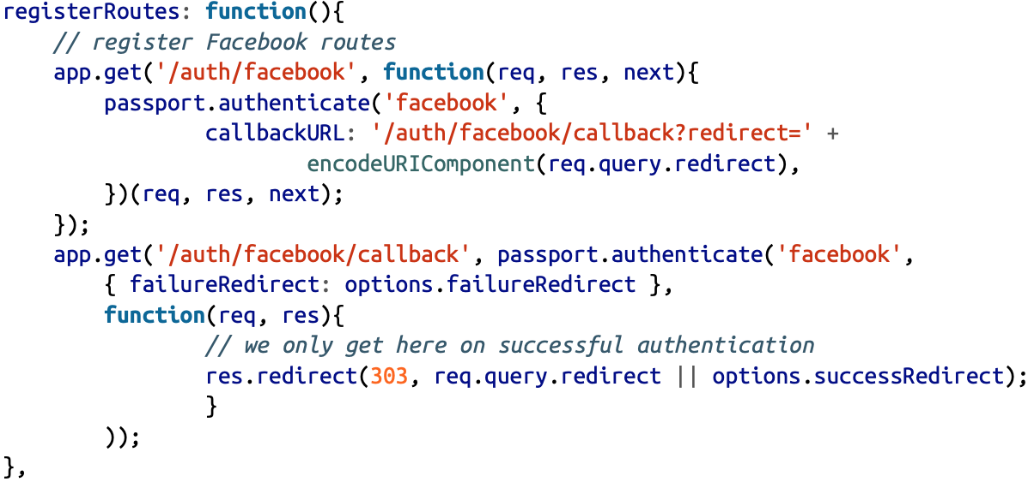
Setting up Passport
The last thing we have to do is create our registerRoutes method

Slide 33
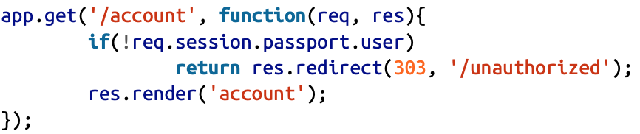
Setting up Passport
Now we have the path /auth/facebook; visiting this path will automatically redirect the visitor to Facebook’s authentication screen
Let’s look at our /account handler to see how it checks to make sure the user is authenticated

Slide 34
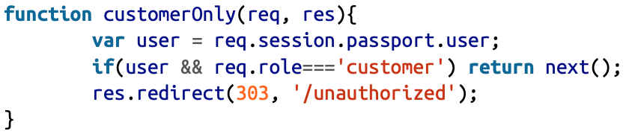
Role-Based Authorization
Let’s say we only want customers to see their account views (employees might have an entirely different view where they can see user account information).
Let’s create a function called customerOnly that will allow only customers:

Slide 35
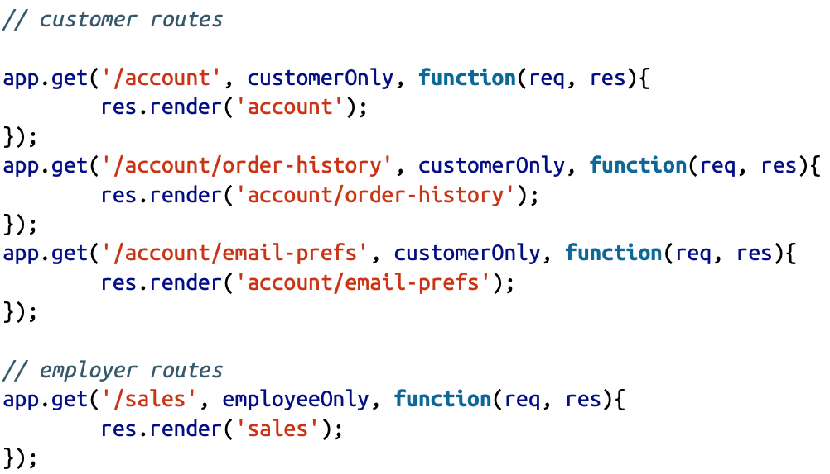
Role-Based Authorization
Here’s how easy it is to put these functions to use:
Write your employeeOnly function.

Slide 36
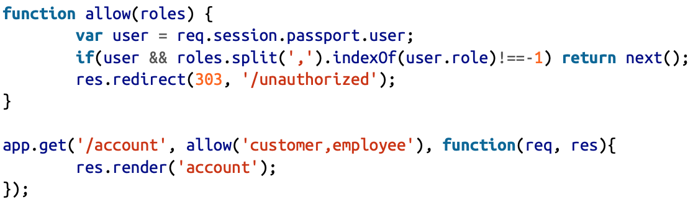
Role-Based Authorization
It should be clear that role-based authorization can be as simple or as complicated as you wish. For example, what if you want to allow multiple roles? You could use the following function and route:

Slide 37
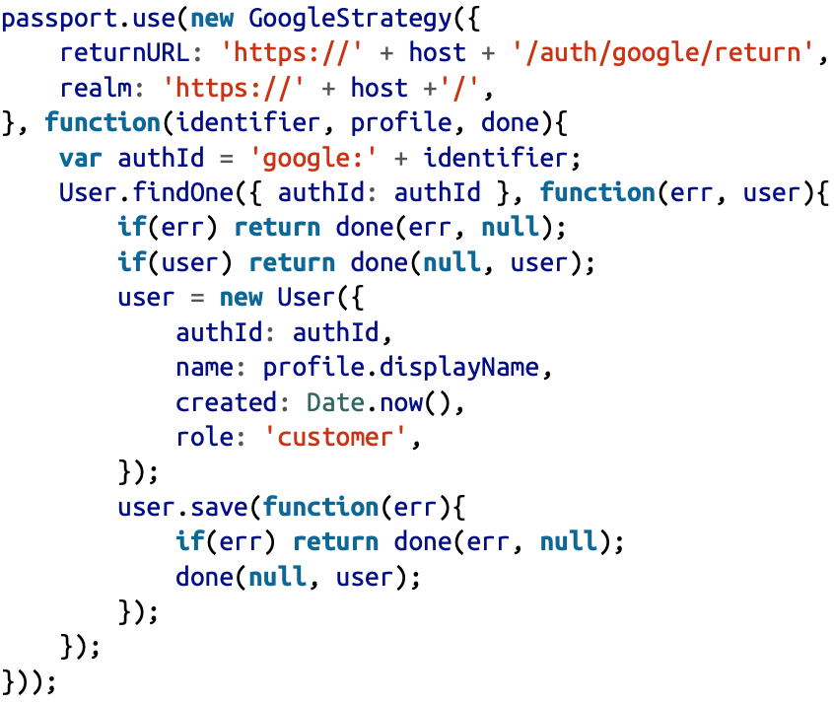
Adding Additional Authentication Providers
We want to authenticate with Google. In the case of Google, we don’t even need to get an app secret or modify our authProviders.js file. We simply add the following to the init method of lib/auth.js:

Slide 38
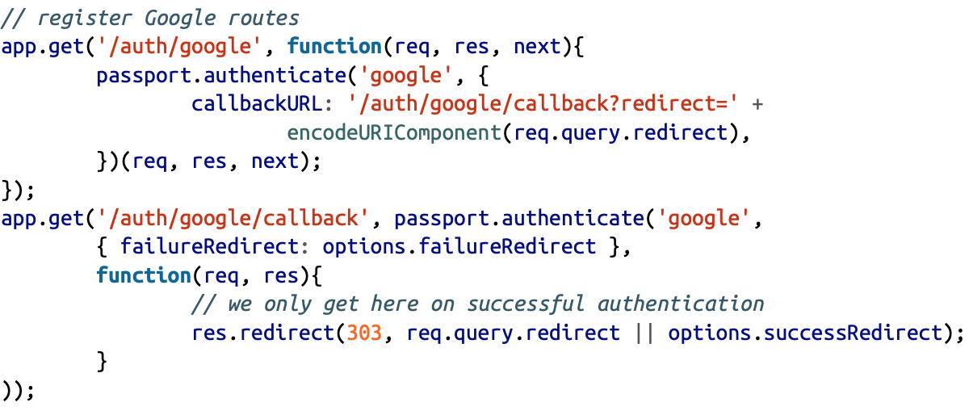
Adding Additional Authentication Providers
And the following to the registerRoutes method:

Slide 39
LocalStrategy
var passport = require('passport')
var LocalStrategy = require('passport-local').Strategy;
passport.use(new LocalStrategy(
function(username, password, done) {
User.findOne({ username: username }, function (err, user) {
if (err) { return done(err); }
if (!user)
return done(null, false, { message: 'Incorrect username.' });
if (!user.validPassword(password))
return done(null, false, { message: 'Incorrect password.' });
return done(null, user);
});
}
));

Slide 40
LocalStrategy
passport.use(new LocalStrategy({
usernameField: 'email’,
passwordField: 'passwd’
},
function(username, password, done) {
// ...
})
);
app.post('/login', passport.authenticate('local’,
{ successRedirect: '/', failureRedirect: '/login' }));
View:
<form action="/login" method="post">
<div>
<label>Username:</label>
<input type="text" name="username"/>
</div>
<div>
<label>Password:</label>
<input type="password" name="password"/>
</div>
<div>
<input type="submit" value="Log In"/>
</div>
</form>

Slide 41
Q & A

